Slide 1
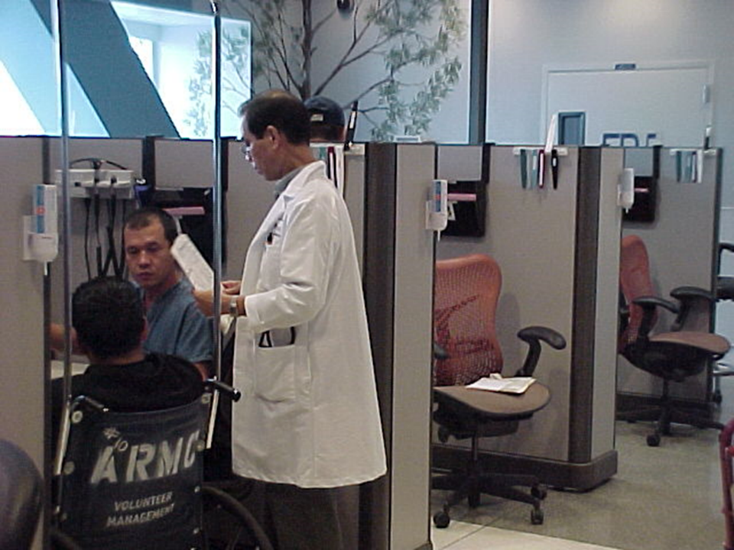
How we can use space, time, human resources better in the ED
Jeffrey Arnold

Slide 2
In 2006
24 bed ED
70K visits/year
Mean 4 hour wait time (time to provider)
15% left without being seen (LWBS)
140 ED deaths/year
CMS core measures all < 80%
Patient satisfaction w doctor overall quality of care < 20 percentile

Slide 3
We had a small overcrowded dysfunctional ED
“I hope you can fix that place.”

Slide 4
By 2010
24 bed ED + 4 bed RME + 14 room Express Care Clinic
140K visits/year
Mean 21 minute TTP
< 2% LWBS
70 ED deaths/year
CMS core measures all 100%
Patient satisfaction w doctor overall quality of care > 90 percentile
US CDC standard = 1 ED bed per 1800 visits

Slide 5
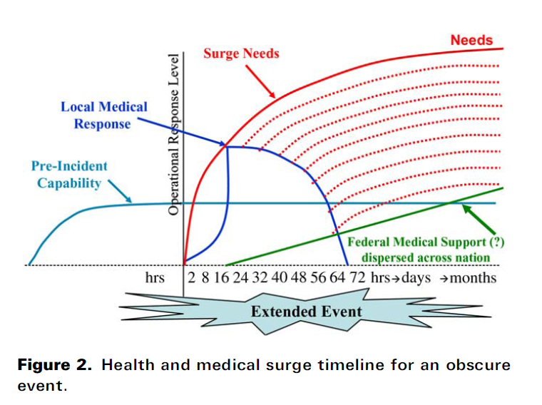

Slide 6
Presentation goals
3 ingredients of change
Data and lessons learned
System performance improvement and operational lessons learned
Leadership and lessons learned
Communication – the glue that keeps it all together

Slide 7
ED data and lessons learned

Slide 8
If you can’t measure it, you can’t manage it
How overcrowded is the ED?

Slide 9
If you can’t measure it, you can’t manage it
How timely is care in the ED?
Left without being seen (LWBS)
Time-to-physician (TTP)
Time-to-discharge (TTD)
Time-to-admission (TTA)
Time to ancillary service completion (lab, imaging)
Time to pain medication

Slide 10
Compare results with benchmarks
Indicator | Benchmark
% Left Without Being Seen (LWBS) | < 5%
Mean time-to-provider (TTP) | < 30 minutes
Mean time-to-discharge (TTD) | < 2 hours
Mean time-to-admission (TTA) | < 4 hours
Mean time-to-CBC (lab test) | < 45 minutes
Meant time-to-CT scan head | < 1 hour
California Emergency Physicians - America

Slide 11
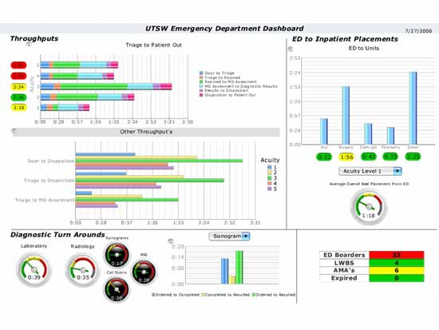
Organize results into real-time dashboards

Slide 12
Measure individual provider performance
Productivity
Patients per hour
Relative value units (RVU)
Timeliness
TTP, TTD, TTA
Resource utilization
Admission rate
CT scan, MRI use

Slide 13
Share results liberally
Transparent feedback about performance provides a powerful motivation for change

Slide 14
ED system performance improvement and lessons learned

Slide 15
Every ED needs a process for system performance improvement
ED performance improvement committee (EPIC _ = highest priority – set this up first!
Standardized process for ED system performance improvement
Receives virtually every operational issue that needs to be fixed
Works closely with ED peer review, which addresses individual provider performance

Slide 16
Understand that EPIC depends on people
Key participants in EPIC
Physician led
Co-led by nursing or administrative leader
Include key representative interdisciplinary stakeholders
Includes key partners but respects their time by only inviting them to meetings for the time they need to be there (e.g., lab, imaging, pharmacy)
Has an executive sponsor
All of our problems walk in on two feet every morning and all of our solutions walk in on two feet every morning

Slide 17
Understand the key features of a robust EPIC
Meets often enough to make a real difference
Agendizes and tracks issues, solutions, metrics, goals, responsible party, timeline
Classic continuous quality improvement
Good to start with “low hanging fruit” issues
Good to test change with pilot studies (“small tests of change”)
Make a field trip to other EDs that have already solved the same problems

Slide 18
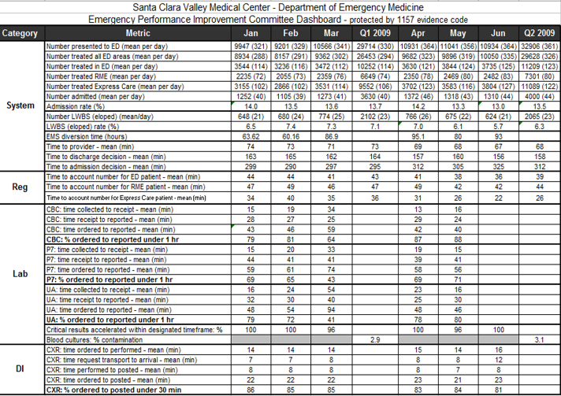
EPIC + data = ED system dashboard
With key ED system metrics
“What gets measured, gets done” – W. Edwards Deming

Slide 19
Understand the benefits of EPIC
Disciplined process for addressing operational issues that need to be fixed
Limits chaotic one-off problem-solving
Instills hope for system improvement - improves staff trust and engagement
ED that better serves patients is easier to work in – job satisfaction

Slide 20
Lessons learned about ED operations

Slide 21
Eliminate waste - ruthlessly
7 deadly sins of manufacturing:

Slide 22
7 wastes in most EDs
Overproduction
Admitting patients who actually should be sent home
Delay – every step of the way!
Transporting
Transporting patients to remote service locations (lab, DI) when they could either self-transport or the service could be brought to them

Slide 23
7 wastes in most EDs
Over-processing
Tests that aren’t needed
Therapy that isn’t needed
Care by less experienced providers
Residents, students, even some attending physicians
Inventory
Staffing mismatched to patient arrival times, needs

Slide 24
7 wastes in most EDs
Motion
Keeping patients in beds or treatment spaces longer than the time required to provide a service
Making defective parts
Poor clinical quality, return visits for admission within 72 hours

Slide 25
Give patients exactly what they need
What do patients not want?
They don’t want to –
Be triaged
See people who can’t fix their problem
Get tests or treatment they don’t need
See specialists they don’t need
Be admitted when they don’t need
Waste time

Slide 26
Give patients exactly what they need
What do patients want?
Rapid access to care
See someone who can definitively take care of their problem (i.e., provider)
Thorough assessment
Listening is more important than tests
Feel better - symptom relief
Caring and compassion
Information

Slide 27
Why rapid access to care?

Slide 28
If you have enough volume, then segment care
3 examples of ED care segmentation:
Rapid medical evaluation within in ED for single system emergency conditions (e.g., lacerations, fractures, ENT complaints)
Express Care Clinic adjacent to ED for self-referring and transferred medium acuity conditions (e.g., abdominal pain w stable VS)
Short stay unit (observation unit) for patients likely to be discharged < 24 hrs (e.g., chest pain, TIA, syncope)
Also segment roles – dedicated phlebotomist, admission nurse, discharge nurse

Slide 29
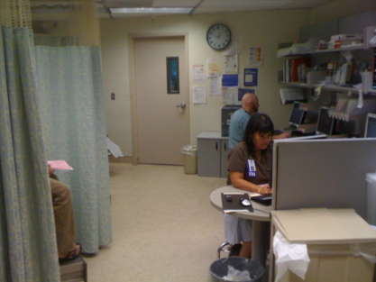
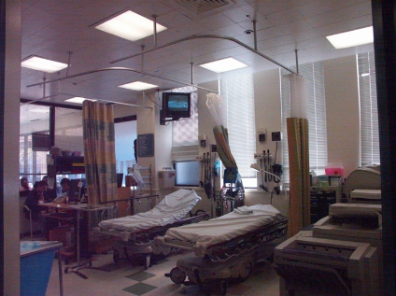
Rapid medical evaluation (RME) is a process not a place
“Accessory bypass tract” for low acuity patients
ED waiting room
Not a fast track because space is small and patients wait in waiting room between care steps – ironically, small space is much more efficient

Slide 30
Keep vertical patients vertical (and in motion)
Do not put a patient supine in a bed unless they actually need a bed
Do not keep patients in beds or treatment spaces longer than the time required to provide the service they need
Cycle them back out
The waiting room is a great place to wait between care steps

Slide 31
Keep vertical patients vertical
Use clinical guidelines that prioritize oral therapy when clinically appropriate:
PO ˃ IM ˃ IV therapy
PO hydration
PO ondansetron
PO hydrocodone and oxycodone
PO antibiotics
Horizontal patients need space, vertical patients need speed

Slide 32
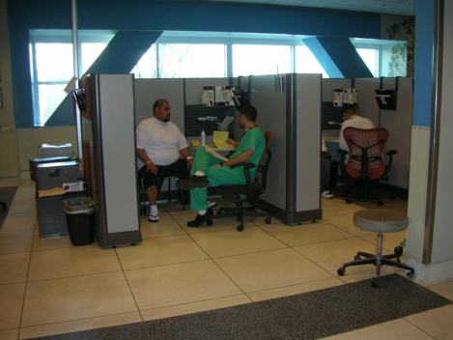
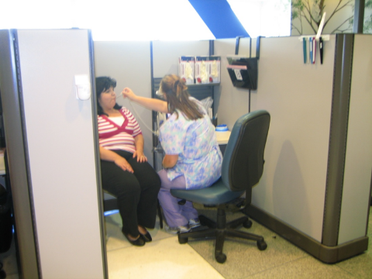
Process patients in parallel
“Simultaneous” beats “sequential”

Slide 33
Occupy patients’ time with activities they feel is valuable
When clinically appropriate, let patients walk to the lab or diagnostic imaging for their tests
“Journeys” out of the ED feel useful and reduce the perception of waiting
Also reduces ED staff workload by leveraging lab and radiology staff

Slide 34
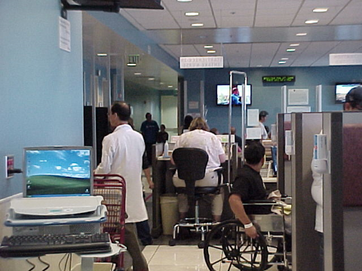
Occupy patients’ time with something they feel is valuable
Return patients to the waiting room or send them home
Never underestimate the importance of a big screen television

Slide 35
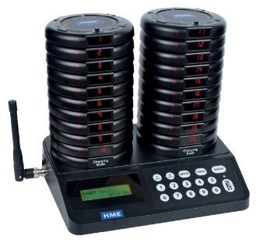
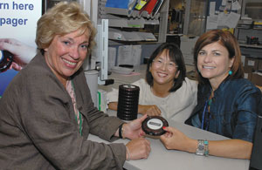
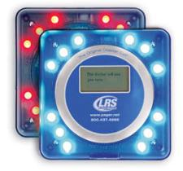
Better yet – give waiting patients a “coaster”

Slide 36
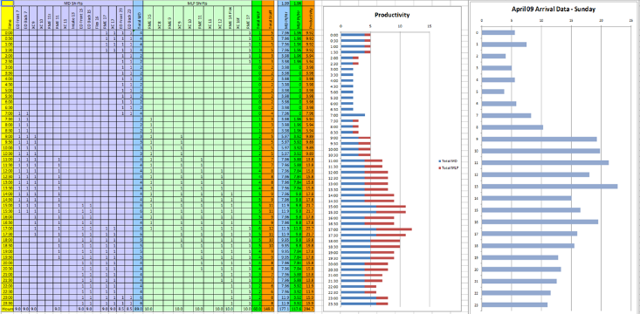
Create a surge staffing model
Match staffing model to arrival time of patients
Create backup staffing for when patient surge exceeds model

Slide 37
Share the care
Add physician extenders and create care teams
“Everyone practicing at the top of their license”
Advanced practice providers (APPs):
Specific scope of practice – low and medium risk patients
We went from 4 to 21 APPs – 55% of all provider hours
Also clarify team member roles – physicians do physician things, APPs do APP things, and nurses do nurse things

Slide 38
Co-locate the entire team
Why do the physicians sit in the back in their offices (“doc caves”) and the nurses sit over there and the ED techs sit over there, etc.?
Put the work stations for the entire team together = “co-location”
Facilitates communication and real-time problem-solving
Improves patient flow
Team huddles also facilitate problem-solving

Slide 39
Standardize care whenever possible
Standardize:
Locations where patients will be treated
Roles of people
Clinical care – tests, treatment, consults, referrals, admission criteria
Especially complex care – STEMI, stroke, sepsis, trauma
Operational processes – intake, triage, registration, RN assessment, discharge, transport

Slide 40
Standardize care whenever possible
Check lists = memory aid – promote standard work
Especially for higher risk processes
Time out before surgical procedure
Central line placement

Slide 41
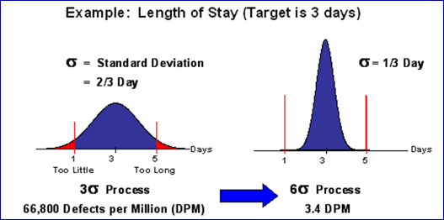
Standardize care whenever possible
Why standards?
Reduce variation, errors, and risk
Enables system to improve

Slide 42
Leverage electronic health record to improve patient flow
Electronic tracking
Standardized templates for complex care
Order sets
Check lists
Eliminate paper forms – ruthlessly – and incorporate into EHR

Slide 43
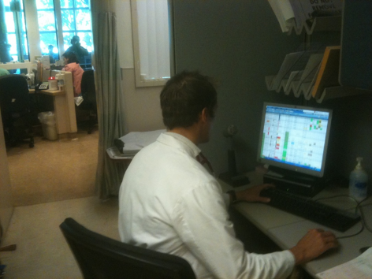
Put the highest level decision-maker as early as possible in the process
Example 1 – physician at intake
Physician at intake sees patient after nurse triage and registration

Slide 44
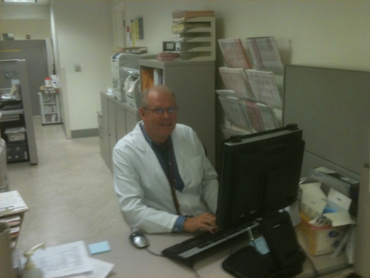
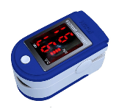
Put the highest level decision-maker as early as possible in the process
Example 2 – physician on arrival
Physician is the first person a patient meets when they walk in the door
Magic!

Slide 45
Difference between physician at intake and physician on arrival
Physician at intake
Physician on arrival
Peak periods
Initiates care
Subject to upstream delays in process
Cleans up labelling of chief complaint
Always playing catch up
TTP = 45 minutes
Peak periods
Simultaneously triages and initiates care
Immediately recognizes sick patients
Accurately labels chief complaint
Assigns patients to appropriate type of provider
Often earlier diagnosis
TTP = 0 minutes

Slide 46
Leadership and lessons learned

Slide 47
Understand the elephant, the rider, and the path
Most change is psychological

Slide 48
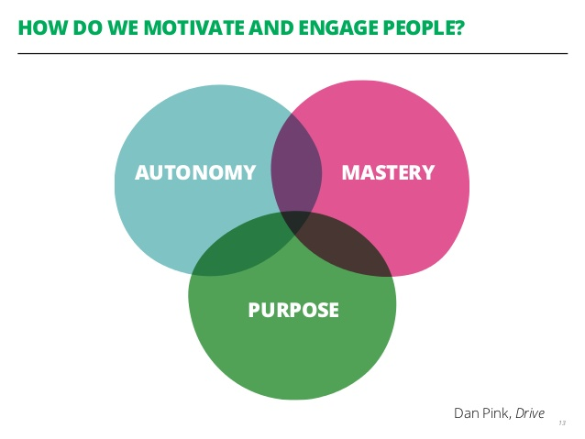
Understand the drivers of autonomy, mastery, and purpose

Slide 49
Understand the tools of leadership
Your main levers are:
Inspire
Influence
Allocate resources

Slide 50
Understand tribal leadership

Slide 51
Don’t hesitate to set goals and use data
Goals should be:
Visible, clear, and known to all
Holistic
Clinical quality performance
Operational performance
Service performance
Business performance
Quantifiable

Slide 52
Don’t hesitate to set goals and use data
Key leadership tool = balanced score card
Area | Goal | Action steps | Measure of success | Responsible party | Target completion date | Progress update Q3 2008
Operations | Improve ED operations | Implement standard order sets Match staffing to patient arrival times | LWBS < 5% | Smith | Q4 2008 | LWBS 5%
Quality | Meet CMS core measures | Deliver group and individual feedback | PCI < 90 min in 75% | Jones | Q4 2008 | PCI 91%
Service | Improve ED patient satisfaction | Initiate AIDET approach | 100% provider awareness of AIDET | Smith | Q4 2008 | All providers aware

Slide 53
Never let a crisis go to waste
2009 – unexpected ED death in ED waiting room
Next day – physician at intake

Slide 54
Think exponentially, not linearly
3 examples of disruptive leadership thinking:
1. Why do we make patients w lacerations and fractures wait so long to be seen?
Rapid medical evaluation (RME)
Patients who need fewer resources should not routinely wait behind patients who need more resources – regardless of how heavy the patient volume load is

Slide 55
Think exponentially, not linearly
2. What if we initiated emergency care in the waiting room?
Replace 50% of ED waiting room with office cubicles where providers can talk to patients, examine them, order tests and treatment and even discharge or admit them
3. What if a physician was the first person patients met when they walked in the door?
Physician on arrival

Slide 56
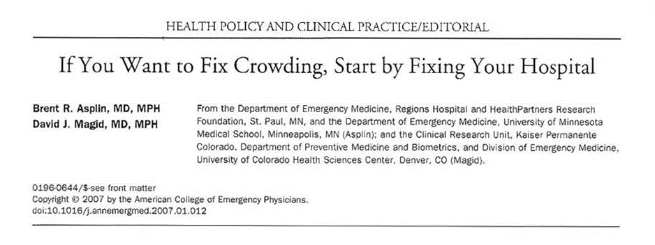
Leadership is a journey
Improve your practice of emergency medicine, then realize you need to improve the ED
Improve the ED, then realize you need to improve the hospital
Improve the hospital, then realize you need to improve the health system
Improve the health system, then realize you need to improve society

Slide 57
Thank you

